Slide 1
Migrate your SSIS skills to ADF
Koen Verbeeck – He/him

Slide 2





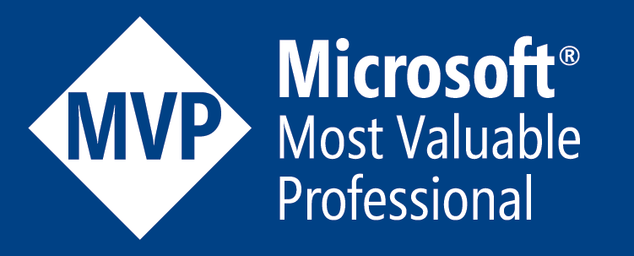

contact
Koen Verbeeck
@Ko_Ver
SQLkover.com

Slide 3
agenda
How do I transfer my skills from SSIS to ADF?

Slide 4



user personas
the ETL developer
the ELT developer
I just want to get rid of SSIS (and my server)

Slide 5
you have 3 options
“lift&shift” existing SSIS projects to ADF
use ADF as an orchestrator
use data flows as well

Slide 6
user personas
the ETL developer
the ELT developer
I just want to get rid of SSIS (and my server)

Slide 7

public service announcement
Most functionality of ADF (but not all) can be found in Synapse Pipelines/Fabric

Slide 8
lift & shift

Slide 9
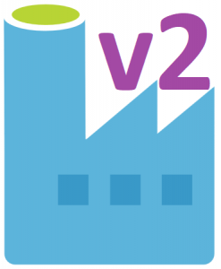



provisioning & management
Azure-SSIS IR (Azure Compute)
SSISDB
Azure SQL DB or Managed Instance
ADF
Cloud
On-premises
SSISDB
author & deploy
manage & schedule
SSDT
SSMS

Slide 10

provisioning & management
Azure-SSIS IR (Azure Compute)
Azure Files
ADF
Cloud
On-premises
author & deploy
manage & schedule
SSDT
SSMS

Slide 11
Azure-SSIS IR
one of three Integration Runtimes
Azure IR – data movement & activity dispatch
Self-hosted IR – data management gateway
Azure-SSIS IR – lift & shift of SSIS projects
“SSIS scale-out cluster on VMs in the cloud”

Slide 12
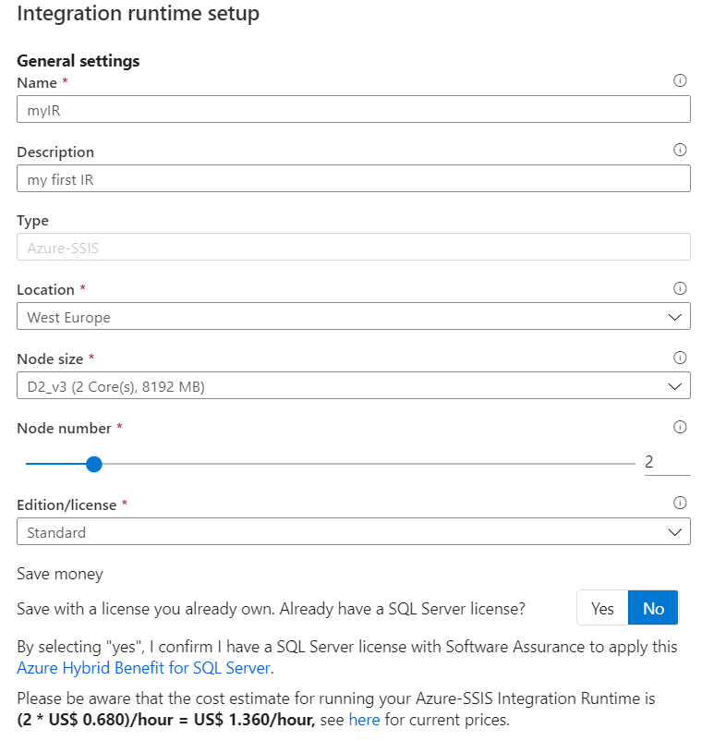

Slide 13
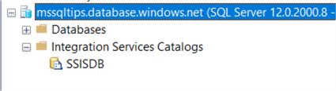
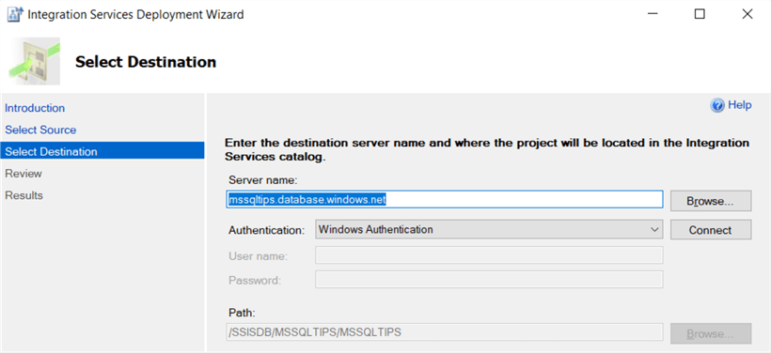

Slide 14
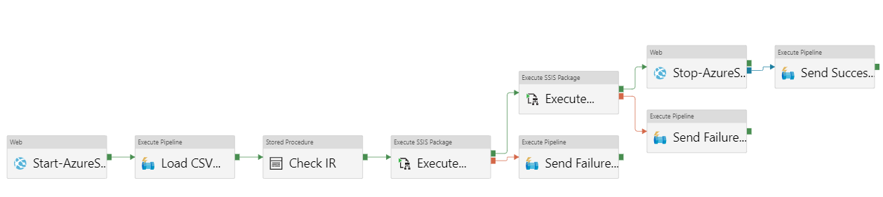
typical flow
automatically start/stop IR
do non-SSIS stuff while IR is starting
coffee time!
run SSIS packages

Slide 15
demo

Slide 16
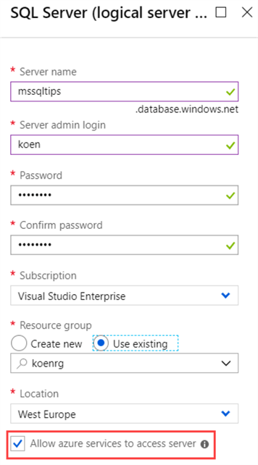
Step 1
Choose location of the SSISDB
Notes:
Azure SQL DB, managed instance or Azure Files

Slide 17
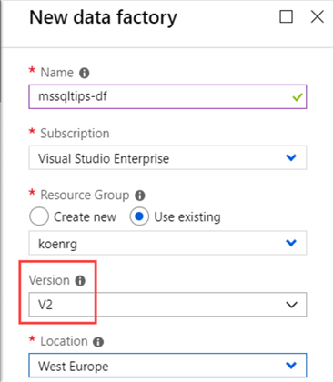
Step 2
Add some PowerShell cmdlets to your machine and create an ADF v2 instance

Slide 18
Step 3
Choose the Azure-SSIS node size

Slide 19
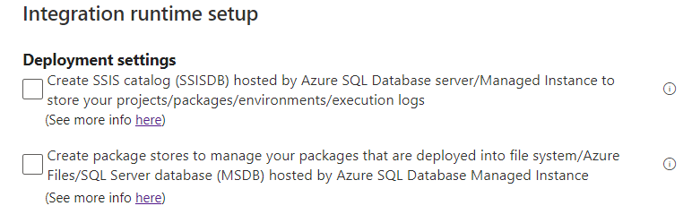
Step 4
Choose where to store your packages

Slide 20
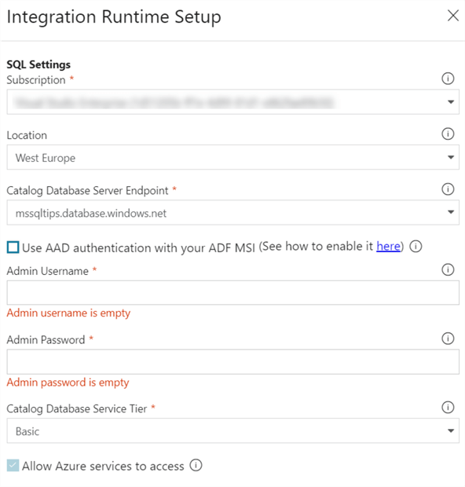
Step 5
Configure connection to SQL Server

Slide 21
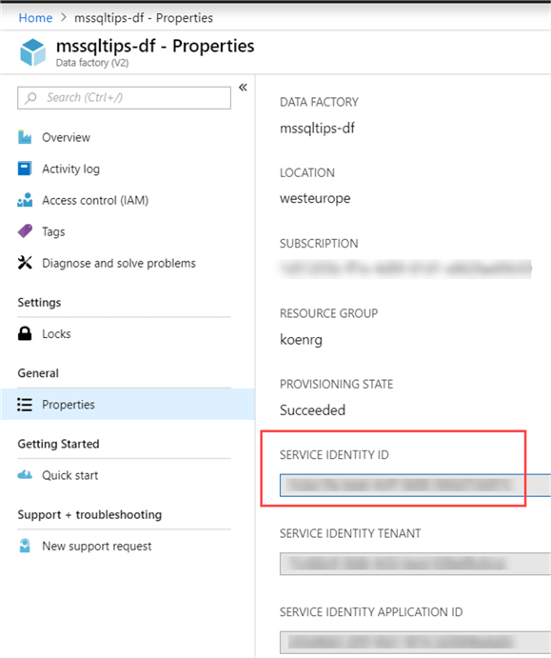
Step 6
If necessary, set up AAD authentication
CREATE USER [SSISIrGroup]
FROM EXTERNAL PROVIDER;
ALTER ROLE dbmanager ADD MEMBER [SSISIrGroup];

Slide 22
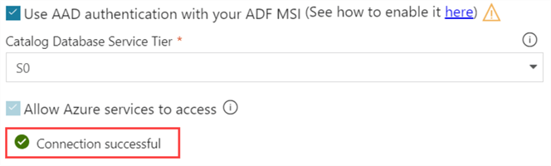
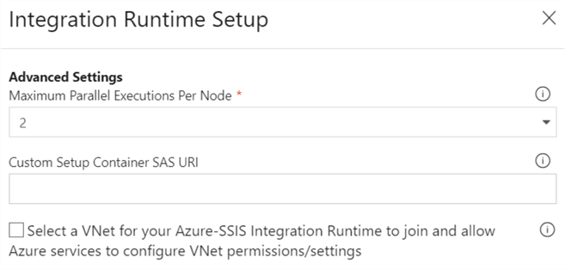
Step 7
Test connection and set number of parallel executions

Slide 23

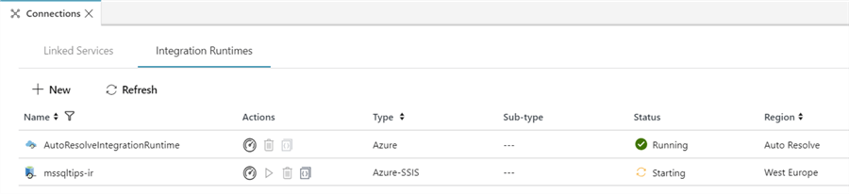
Step 8
Go grab some coffee

Slide 24
Step 9
Deploy your SSIS project to the SSIS catalog

Slide 25
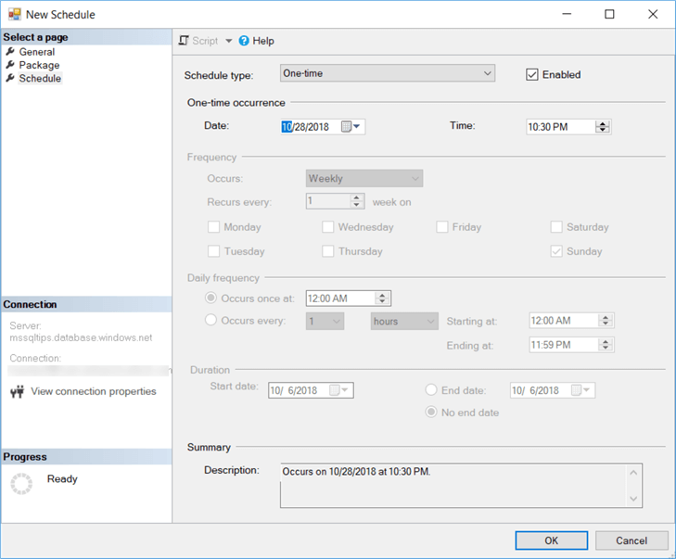
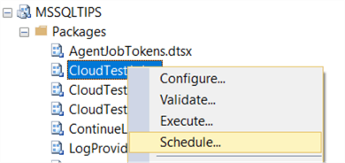
Step 10
Schedule your SSIS packages

Slide 26
skills needed?
learn how to set up and configure the IR
figure out if you need a custom setup
what about on-prem data?
maybe migrate on-prem files to Azure Files
basic pipeline/trigger functionality in ADF

Slide 27
want to learn more?
On-demand webinar at MSSQLTips.com

Slide 28
user personas
the ETL developer
the ELT developer
I just want to get rid of SSIS (and my server)

Slide 29
use ADF as an orchestrator

Slide 30
A fully managed, serverless data integration service. Visually integrate data sources with more than 90 built-in connectors at no added cost. Easily construct ETL and ELT processes code-free in an intuitive environment or write your own code.

Slide 31
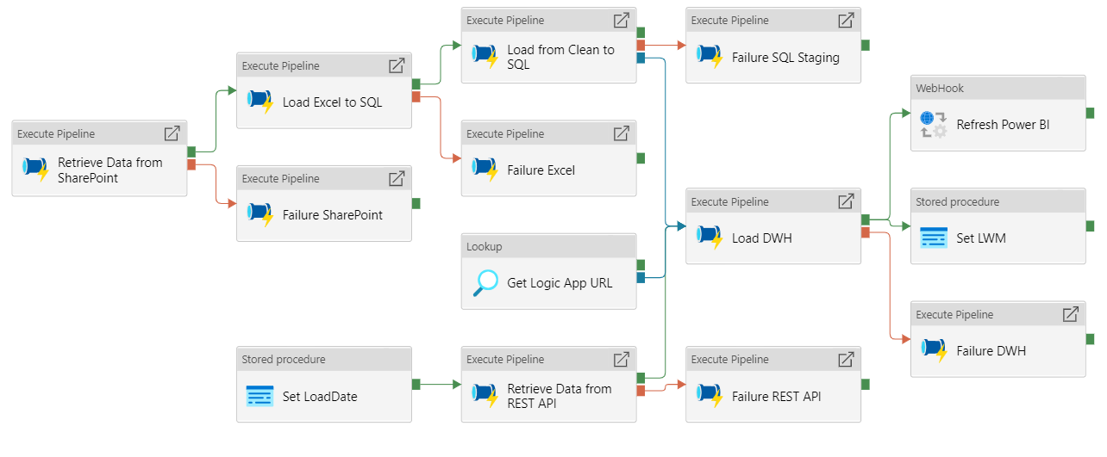
pipeline = control flow

Slide 32
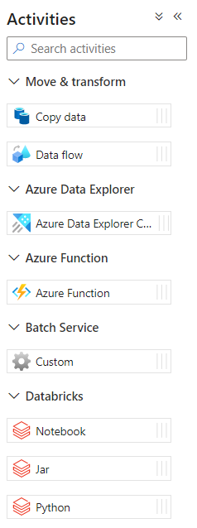
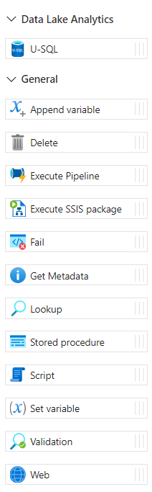
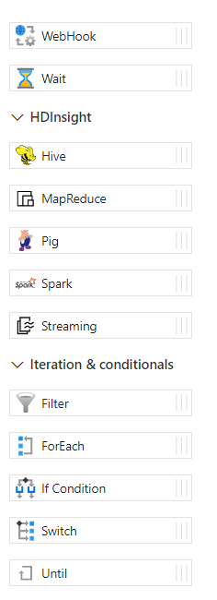
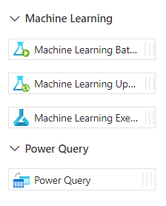
activities = control flow tasks

Slide 33

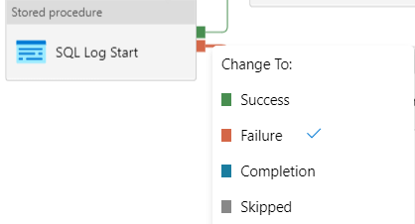
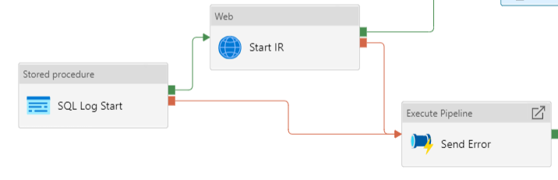
precedence constraints?

Slide 34
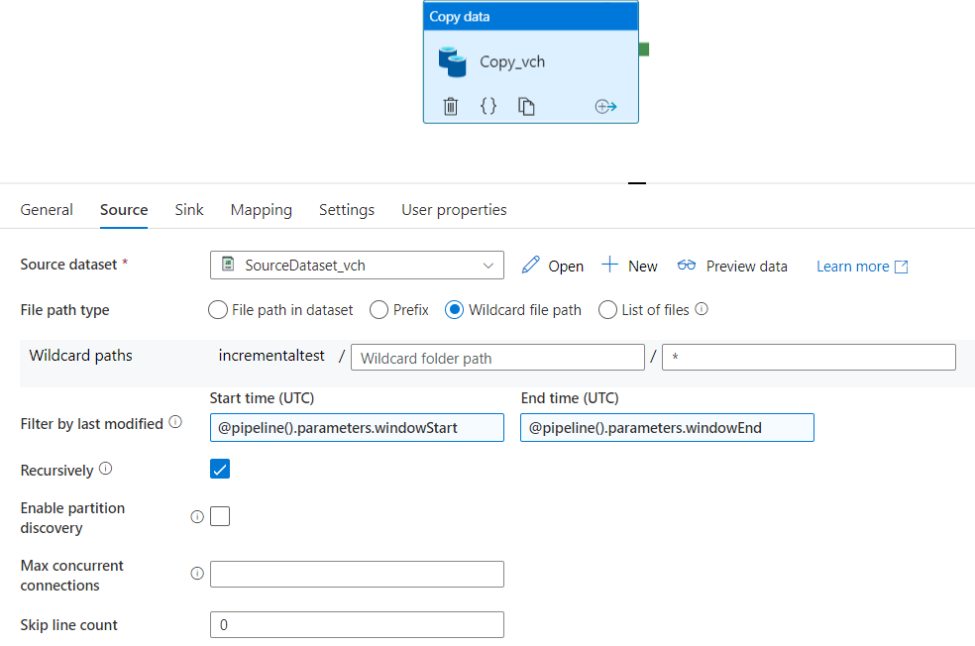
copy data activity = data flow with only source and destination

Slide 35
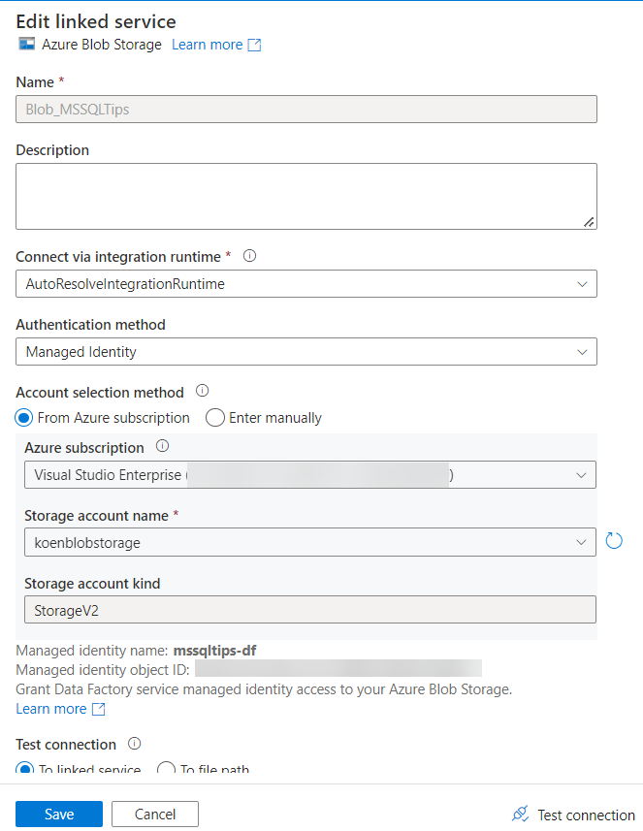
linked service = connection manager
points to a certain data location
contains info on how to authenticate
can integrate with Azure Key Vault

Slide 36
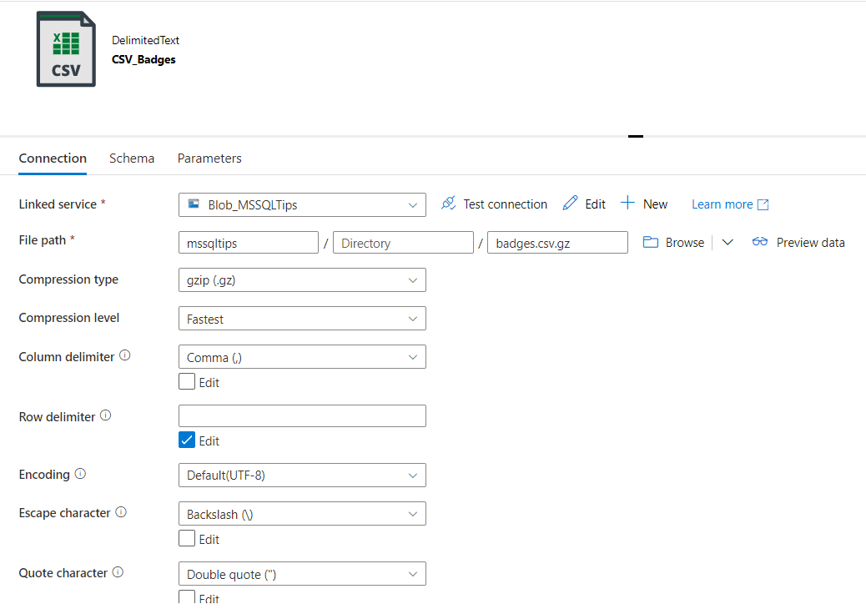
data set

Slide 37
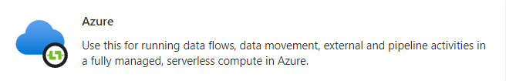
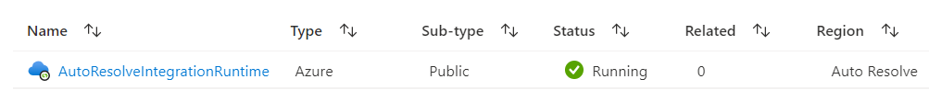


integration runtimes

Slide 38
demo

Slide 39
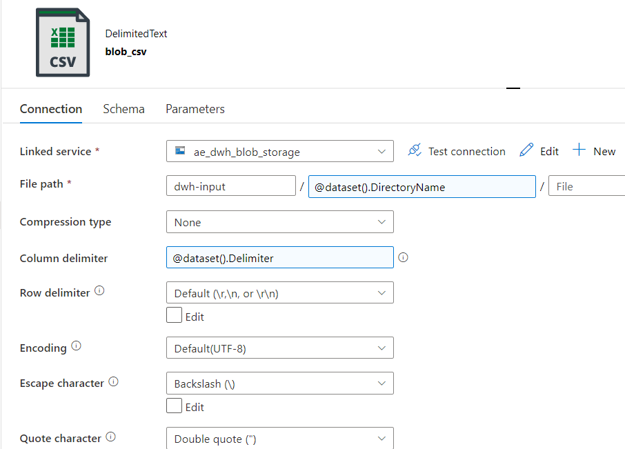
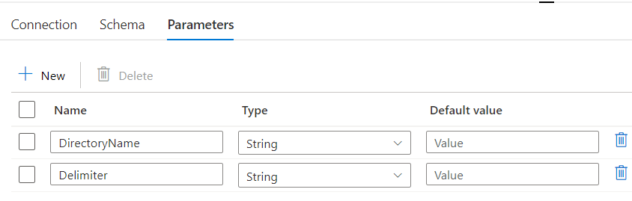
metadata ftw = forget about BIML

Slide 40
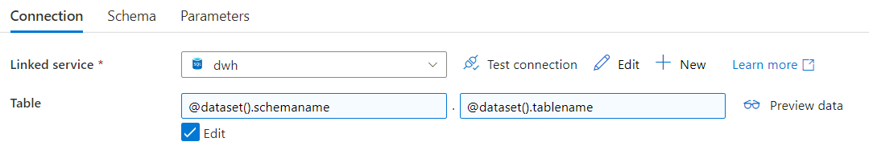
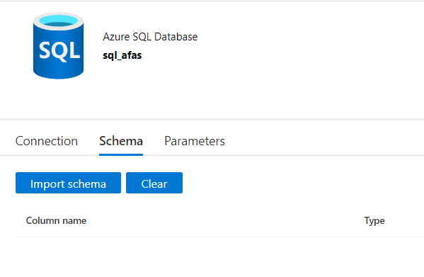
parameterize everything

Slide 41
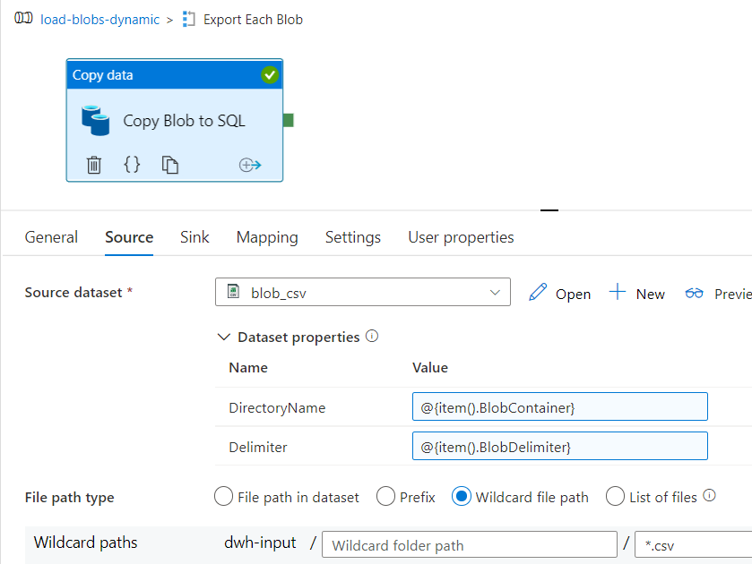
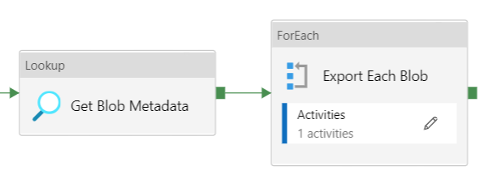
fetch metadata & loop

Slide 42
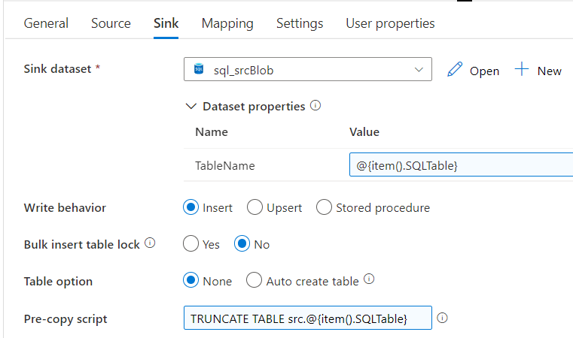
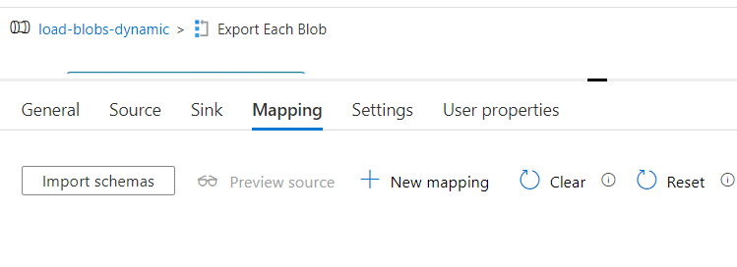
fill parameters at runtime
no need for mapping in simple use cases
use dynamic content

Slide 43
demo

Slide 44
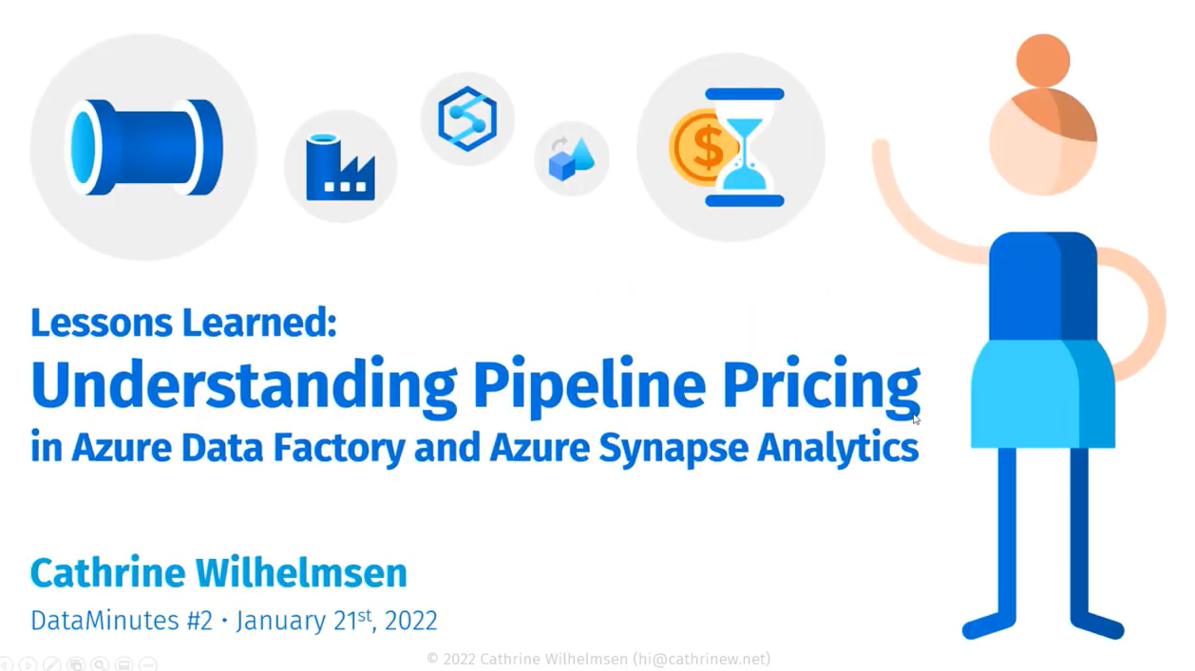
cost
https://youtube.com/watch?v=Fct1dcZMyWs

Slide 45
important to remember
ALL ACTIVITIES ARE PRO-RATED BY THE MINUTE
AND ROUNDED UP

Slide 46
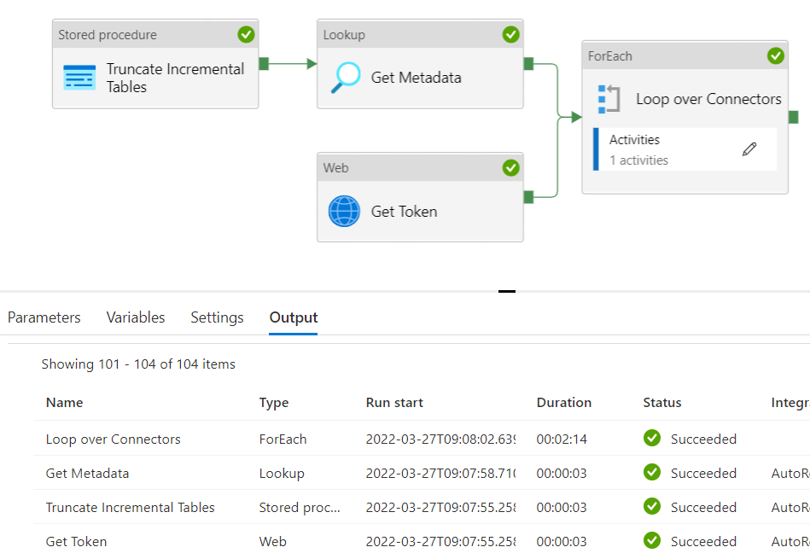
example
2 minutes and 23 seconds runtime

Slide 47
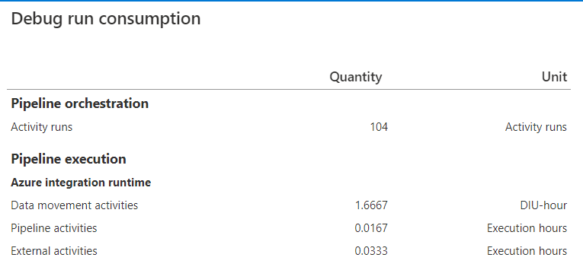
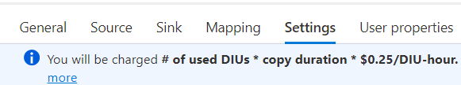
example
Orchestration (Azure-IR): $0.001/run
Pipeline (Azure-IR): $0.005/hour
$0,0000835/run
External (Azure-IR): $0.00025/hour
$0,000008325/run
Data Movement (Azure-IR): $0,25/hour
→ 2 * 1.6667 * $0.25 = $0,83335/run
$0,834441825 / run
once every day: $25.03
once every hour: $600.80
once every 5 min: $7209.58
1 minute
100 minutes!
2 minutes

Slide 48
skills needed?
learn about pipelines, activities, variables and parameterization
a new expression language
luckily, it’s just as infuriating as a derived column
finally get to use some decent git and CI/CD
forget about Visual Studio!
start thinking about creating generic pipelines
use Copy data activity for data transfer
sometimes use complex sources, like REST API
but also learn other Azure tools
Logic Apps, Azure Functions, Azure Keyvault …

Slide 49
want to learn more?
Introduction to ADF at MSSQLTips.com
Beginner's Guide to Azure Data Factory by Cathrine Wilhelmsen
+ other online resources, books, videos…

Slide 50
user personas
the ETL developer
the ELT developer
I just want to get rid of SSIS (and my server)

Slide 51
using data flows

Slide 52
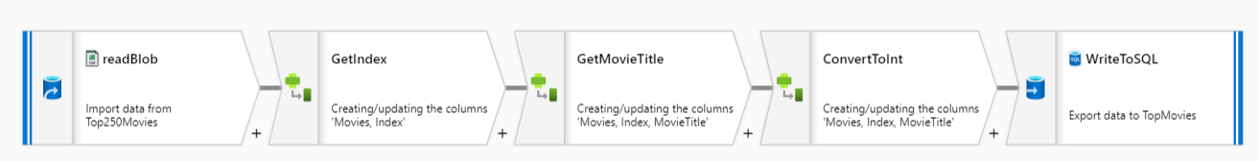
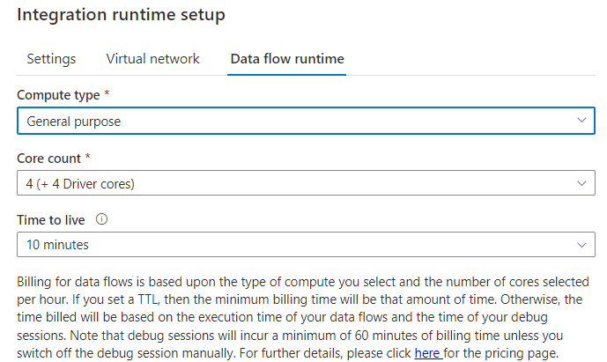
(mapping) data flow ≈ SSIS data flow

Slide 53
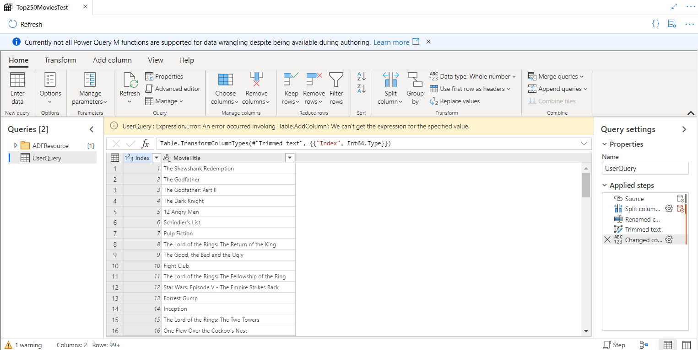
Power Query

Slide 54
demo

Slide 55
skills needed?
bit more of a learning curve
get to know the transformations
some offer “generic” calculations
asserts can be useful for data quality checks
learn about partitioning, schema drift …
don’t get too frustrated with the cluster startup time
learn to write code because you got frustrated

Slide 56
conclusion

Slide 57
advantages of SSIS
mature ETL/ELT tool
easily extensible with .NET
you can create your own components
costs are paid up front (server + licensing)
it doesn’t matter how often you run a package
or how many tasks are in a package

Slide 58
advantages of ADF
cloud scale
no upfront investment (monthly cost)
metadata-driven
choice of runtime
git integration

Slide 59
disadvantages of ADF
harder to debug
no option to disable activities
can’t run a single activity
cost can be brutal
still lacks functionality
send an email?
solve with Logic Apps or Azure Functions

Slide 60
want to learn more?
Dynamic Datasets in Azure Data Factory
Dynamically Map JSON to SQL in Azure Data Factory
Beginner's Guide to Azure Data Factory
Intro to ADF tutorial
Lots of conferences have recordings online

Slide 61
thank you

